Slide 2
Table of Contents
KIC Model UN Secretariat
Conferences
More about us
How to Apply
Q&A
Contact Us

Slide 3
KIC Model UN SECRETARIAT
Established in 2008 as Independent Student Organization
People who Organize Model UN Conferences
Organized and Hosted over 50 conferences
5 Conferences per year
KIMO (Outreach Partnership Program)
Frontier of Korea Model United Nations
“Model United Nations” as an Education

Slide 4
KIC Model UN SECRETARIAT
Organizes Model United Nations Conferences
Much more focused than participating in conferences as a Delegate
But Still Granted Chances to Participate in Various Positions

Slide 5
Conferences

Slide 6
Conference
Kyung Hee International Model United Nations
Expecting in May (Academic Week)

Slide 7
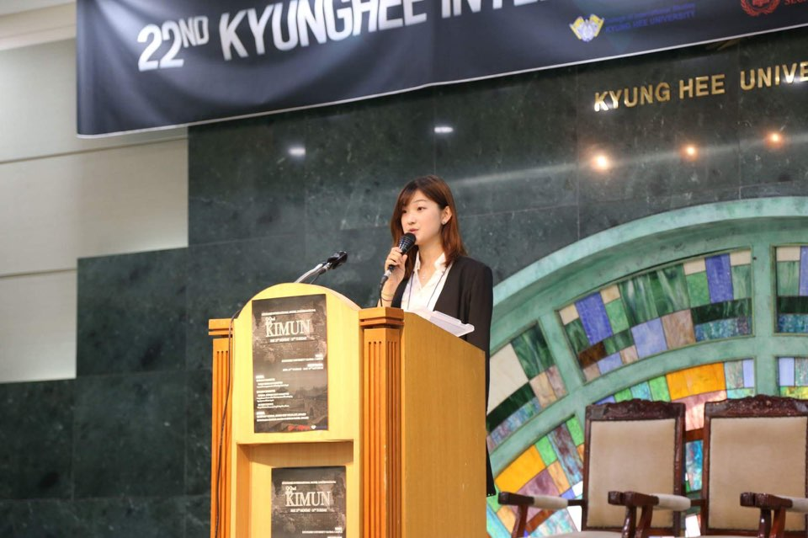
Conference
Kyung Hee International Model United Nations
May (Academic Week)

Slide 8
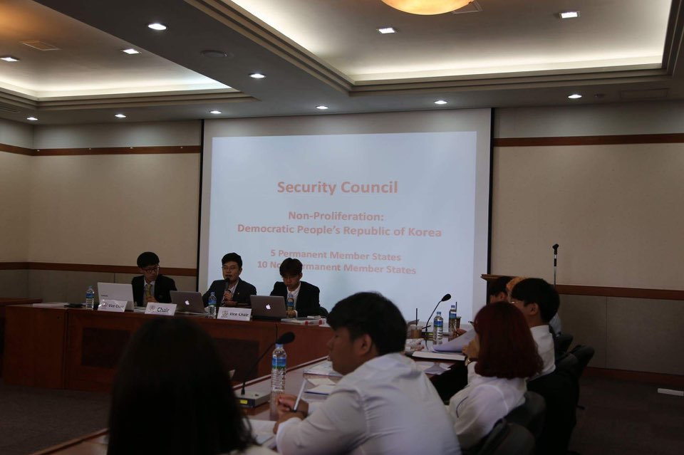
Conference
Kyung Hee International Model United Nations
May (Academic Week)

Slide 9
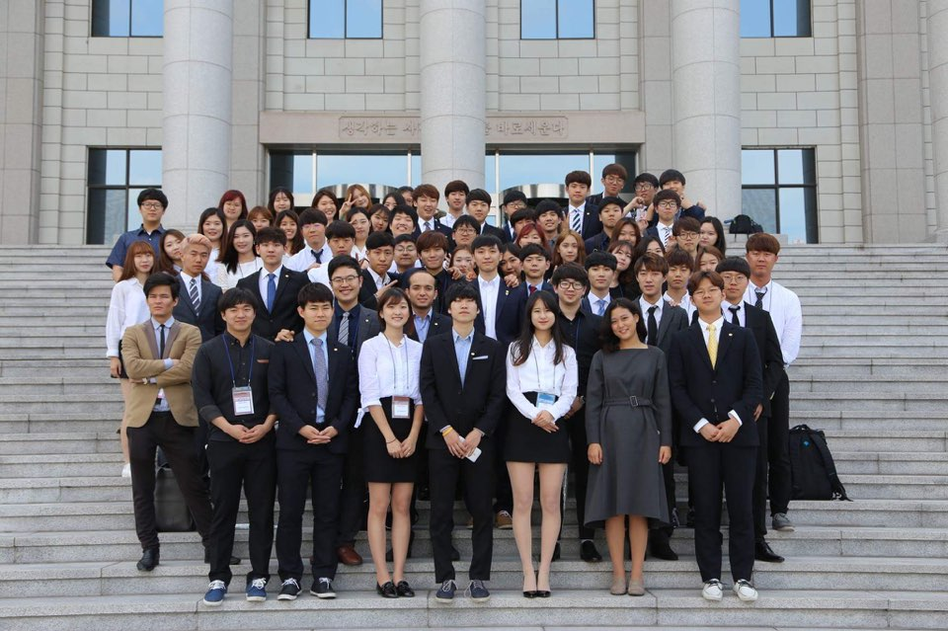
Conference
Kyung Hee International Model United Nations
May (Academic Week)

Slide 10
Conference
KIMUN Workshop
July

Slide 11
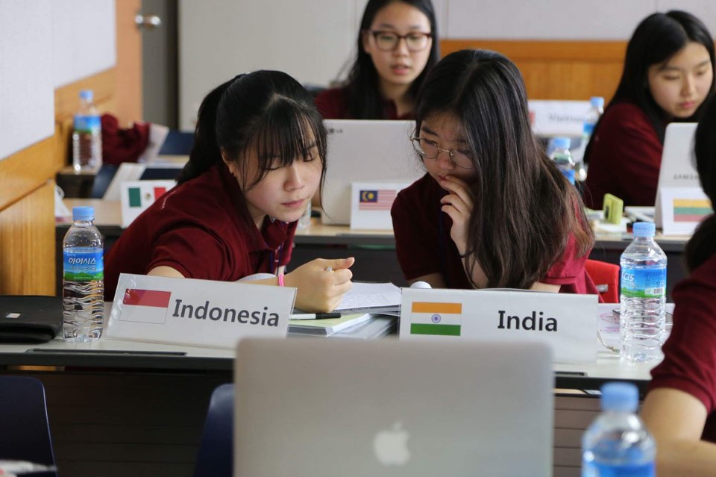
Conference

Slide 12
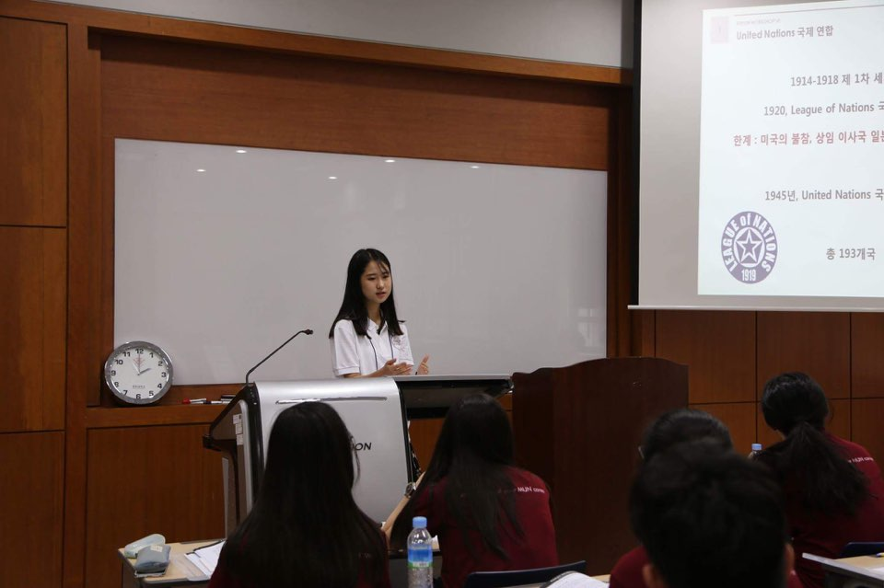
Conference

Slide 13
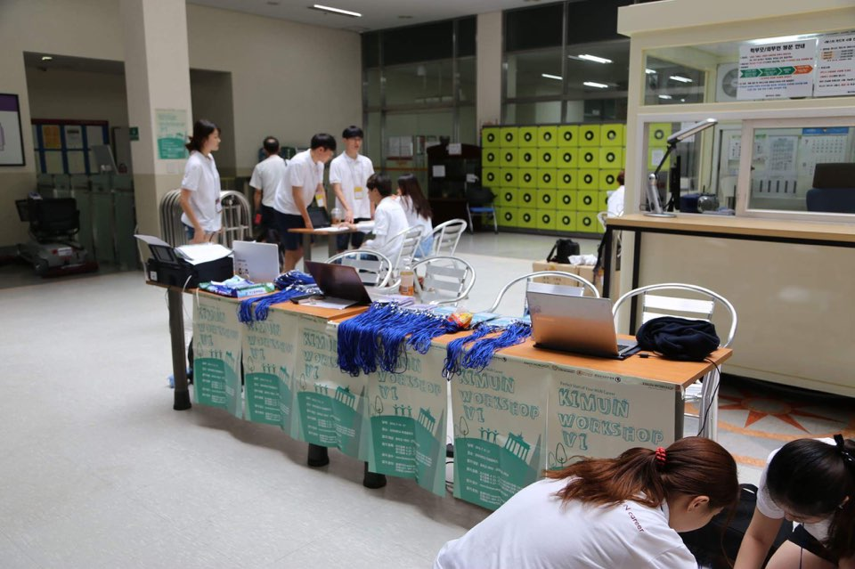
Conference

Slide 14
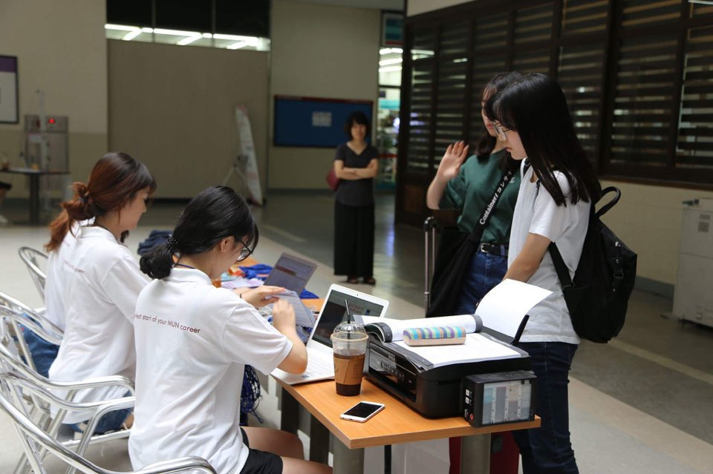
Conference

Slide 15
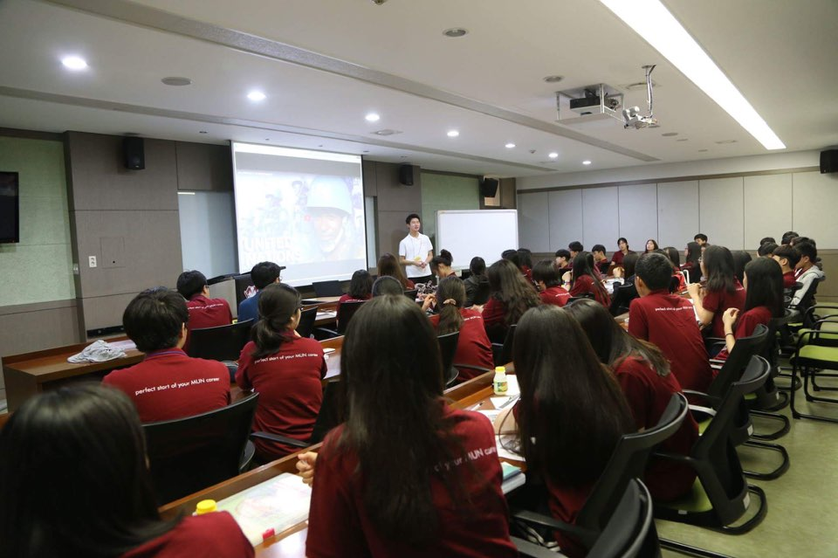
Conference

Slide 16
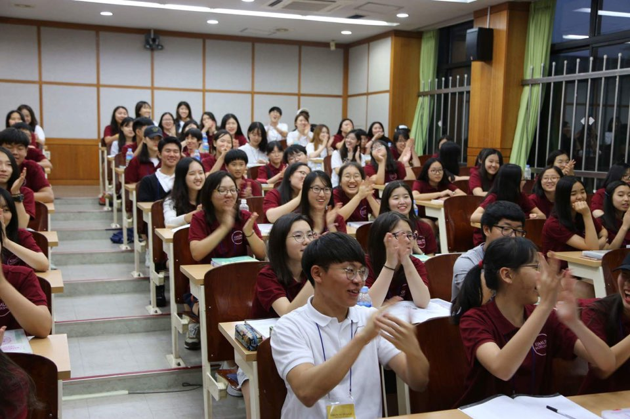
Conference

Slide 17
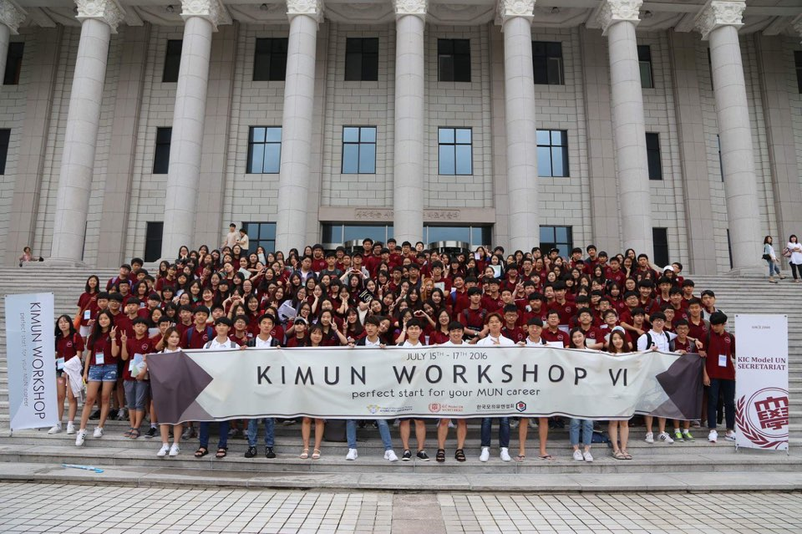
Conference

Slide 18
Conference
World Federations Association of United Nations
WFUNA Youth Camp Korea
July

Slide 19
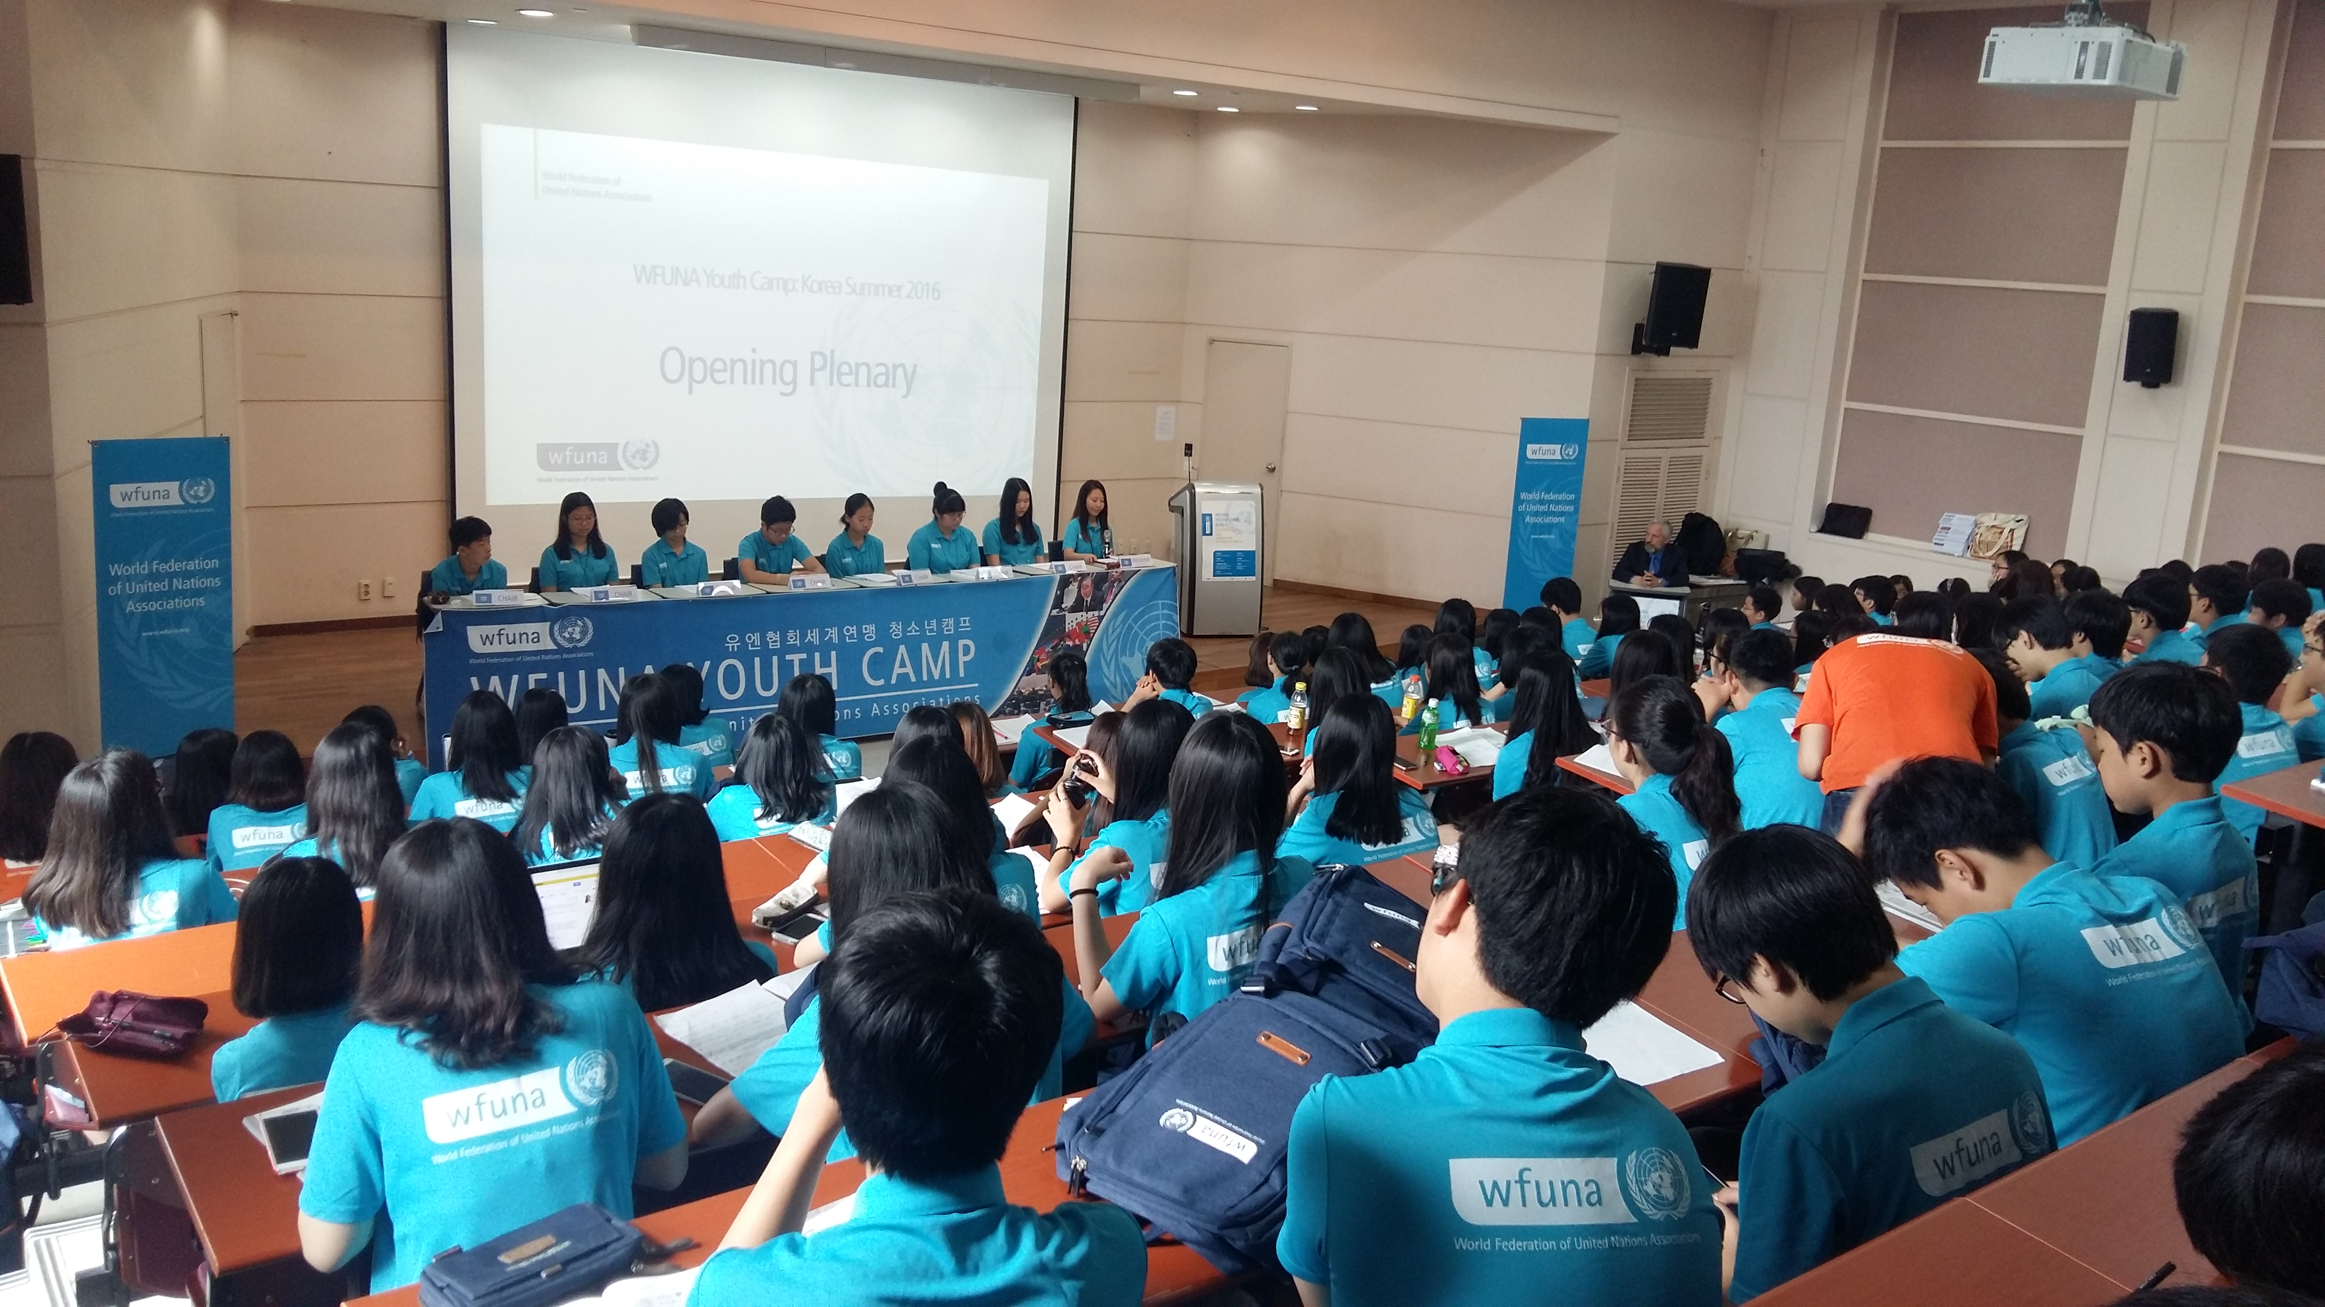
Conference

Slide 20
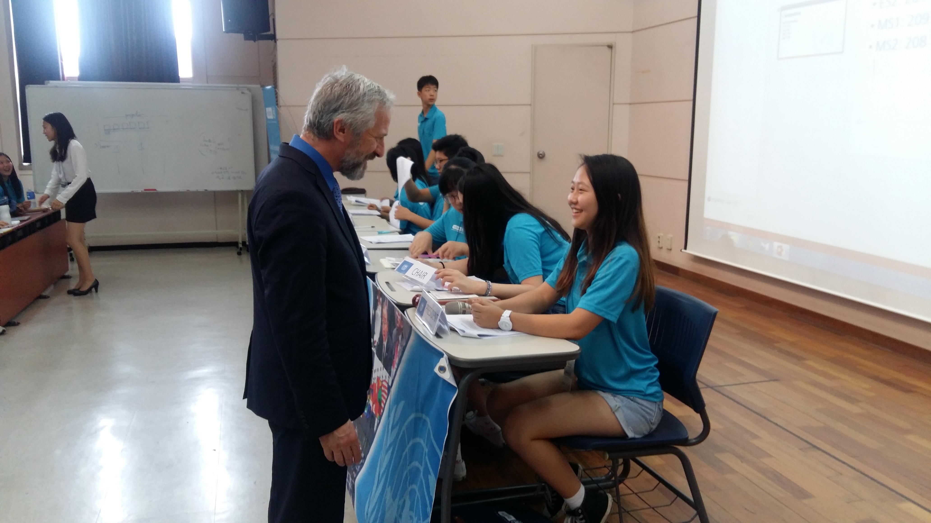
Conference

Slide 21
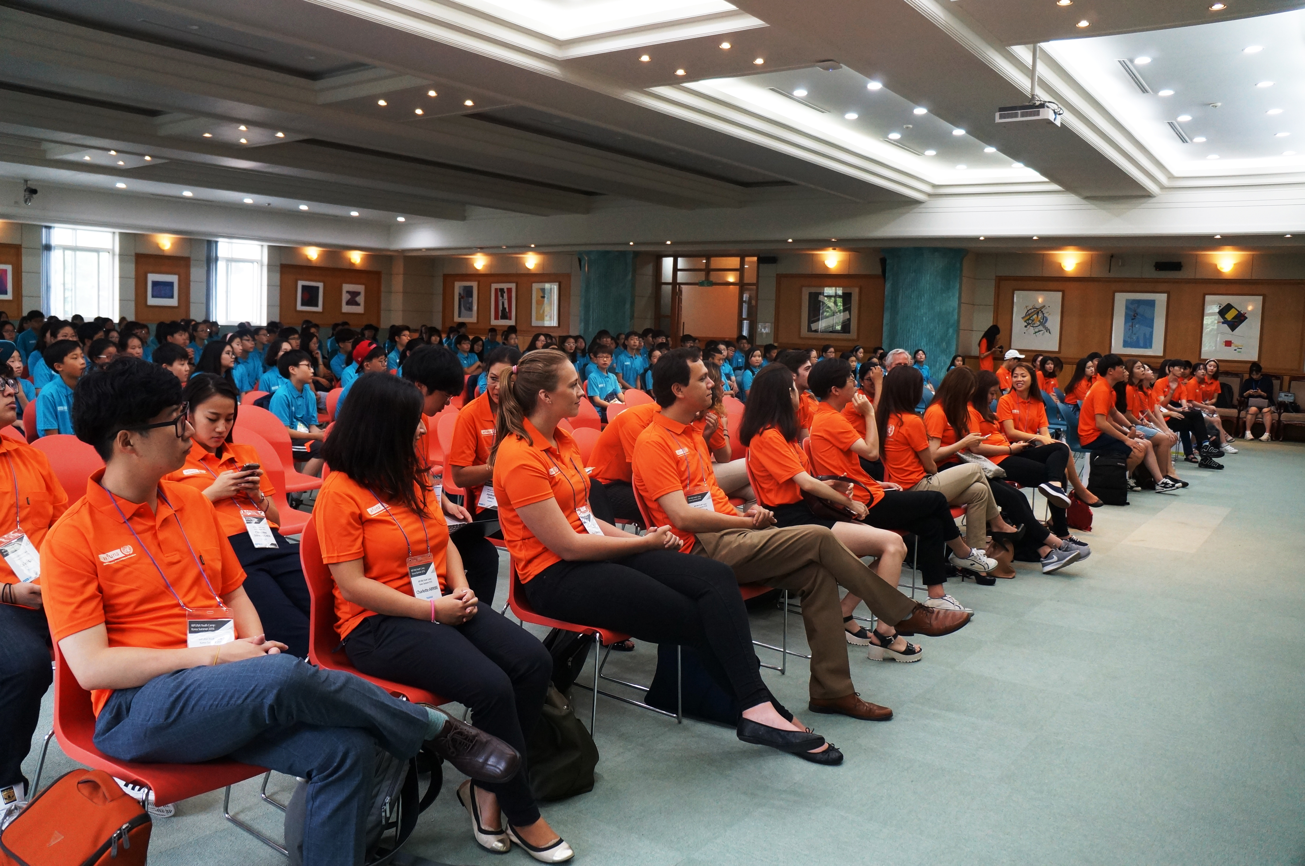
Conference

Slide 22
Conference
G20 Kyung Hee Summit
Expecting in November

Slide 23
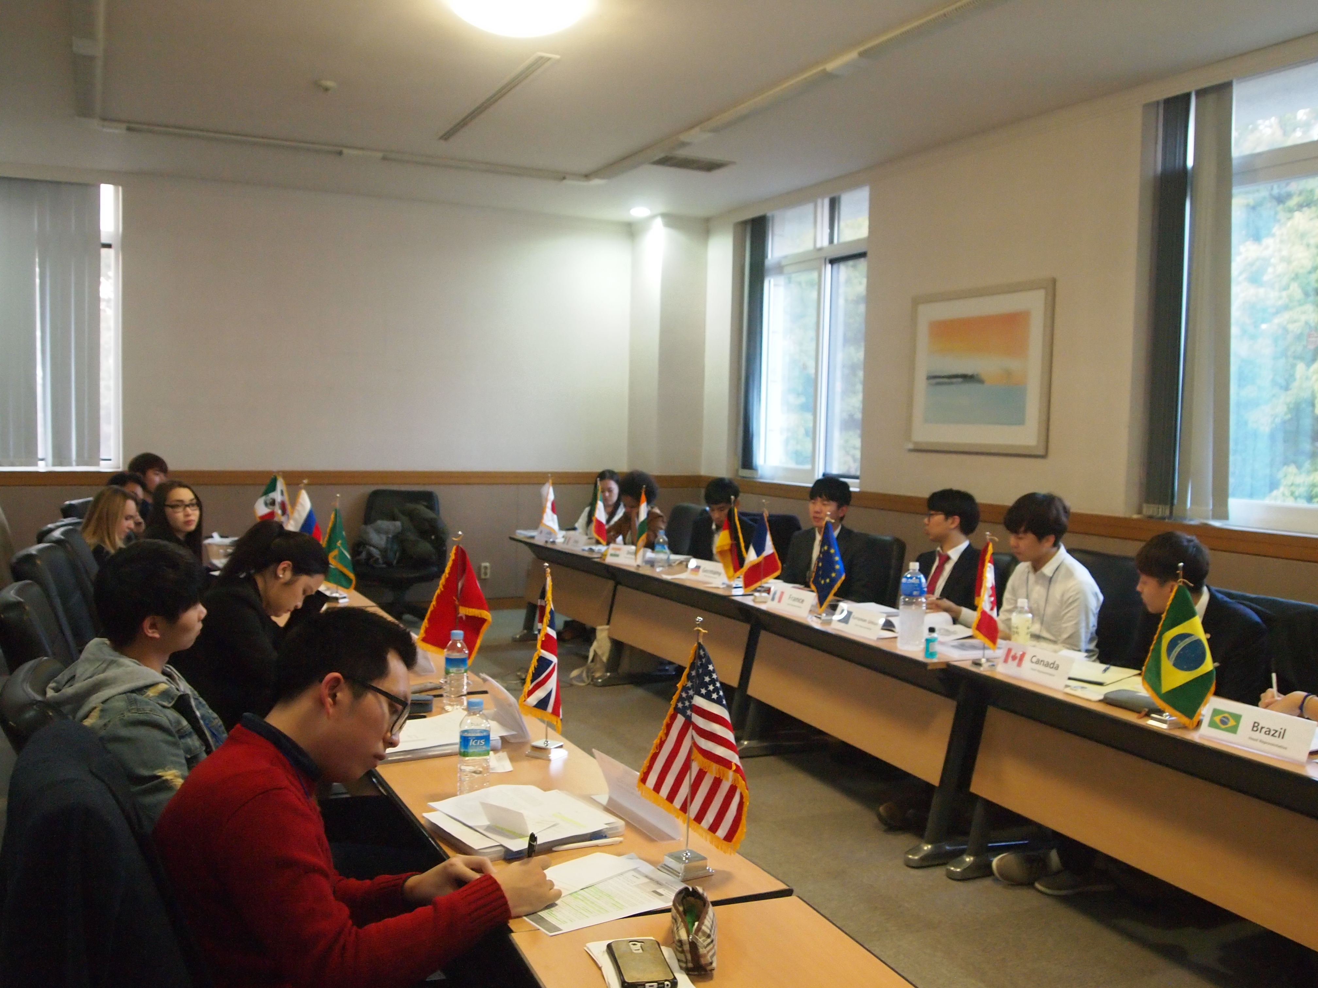
Conference

Slide 24
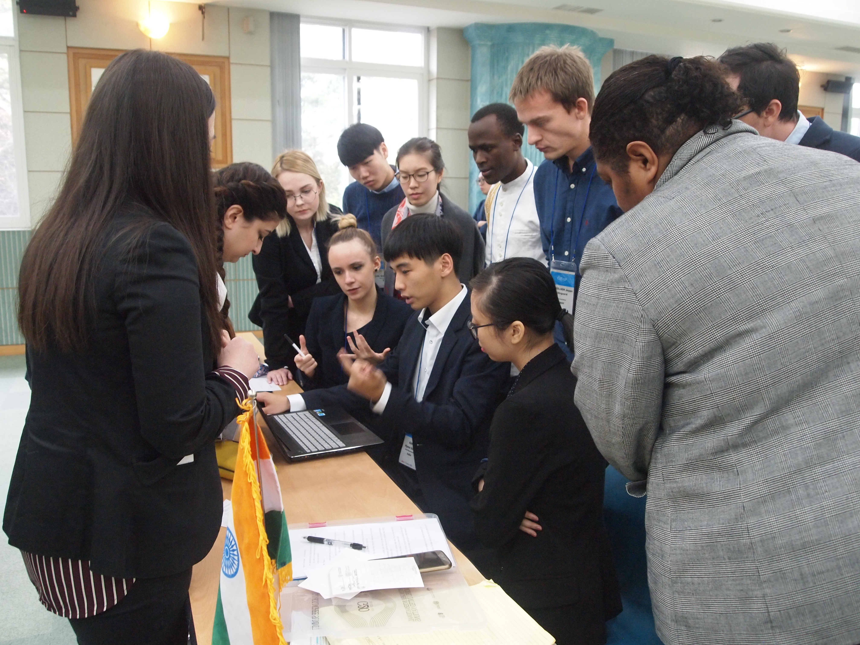
Conference

Slide 25
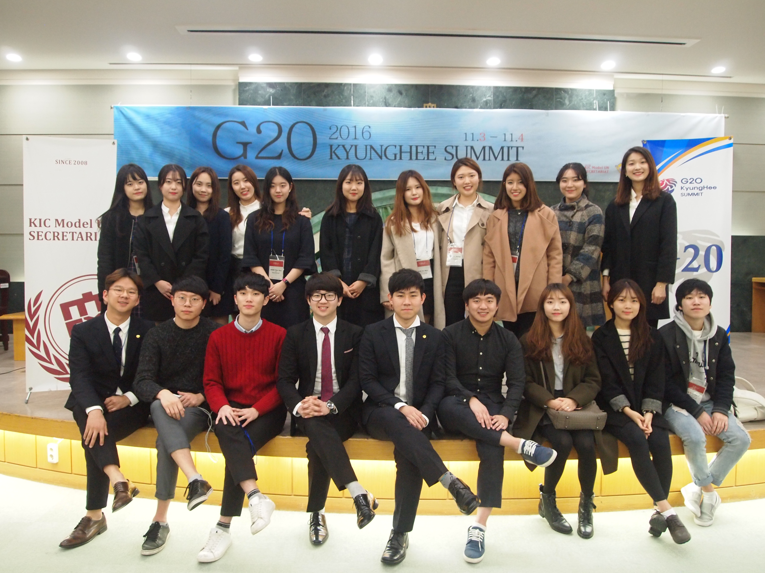
Conference

Slide 26
Conference
Global Classrooms: Seoul
January

Slide 27
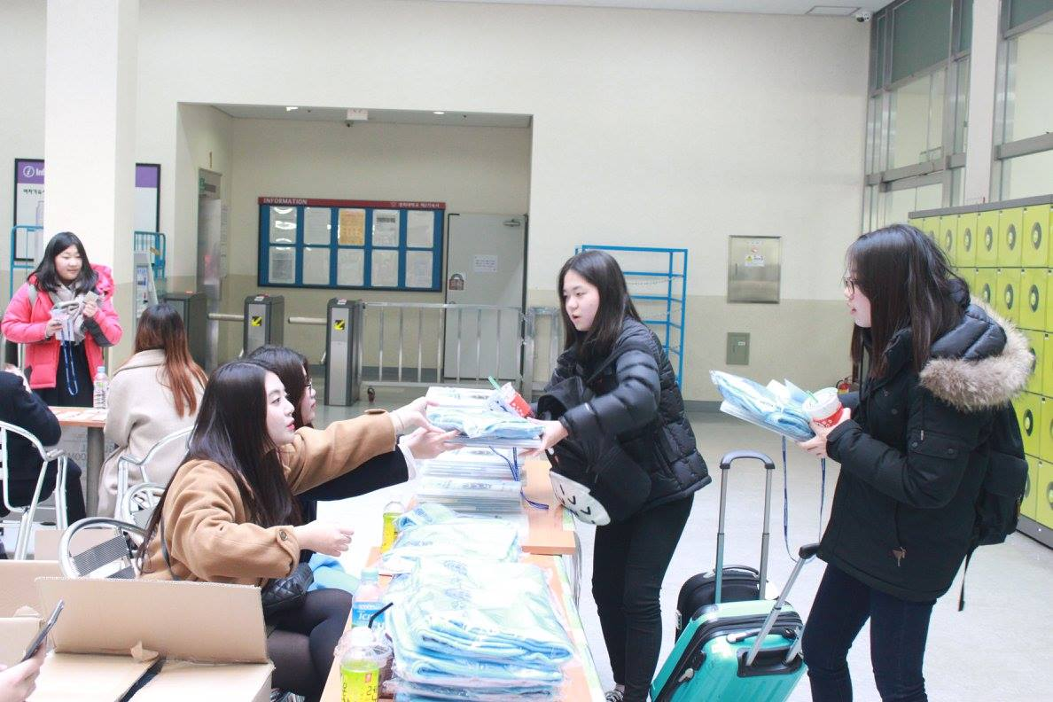
Conference

Slide 28
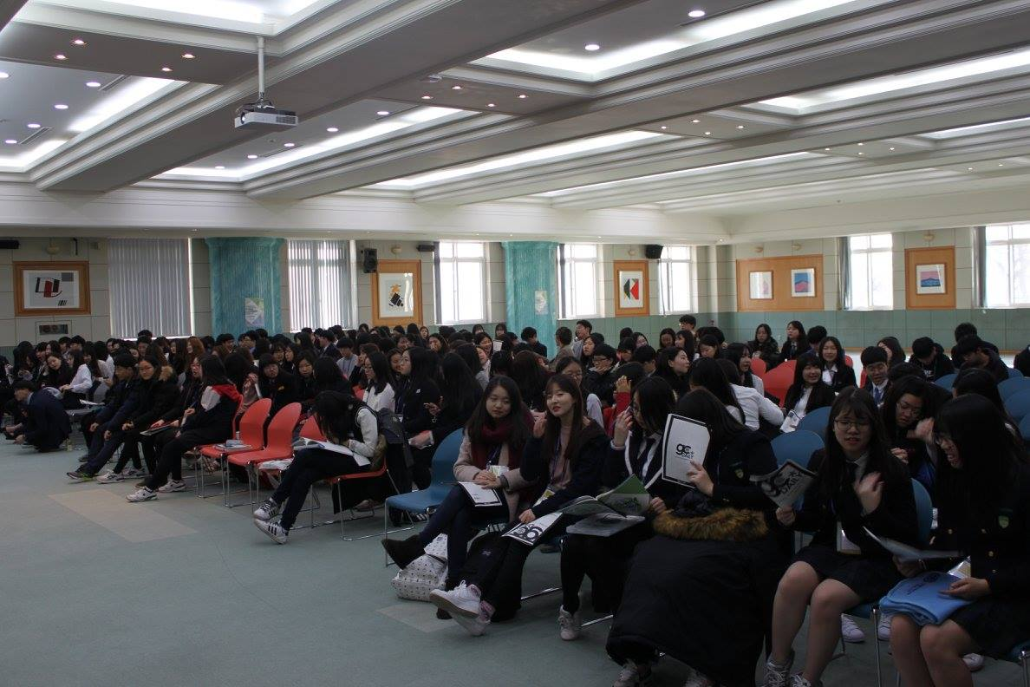
Conference

Slide 29
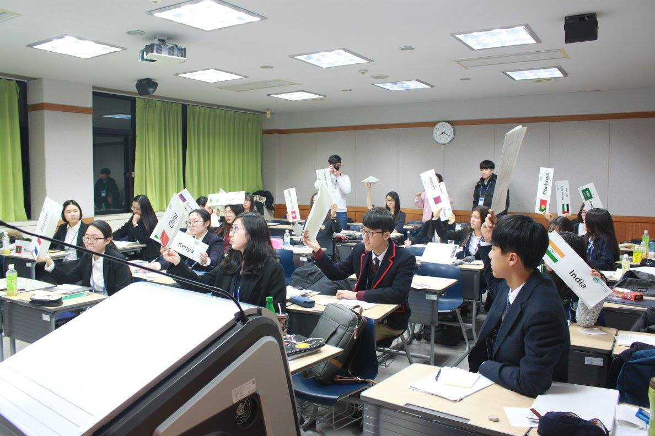
Conference

Slide 30
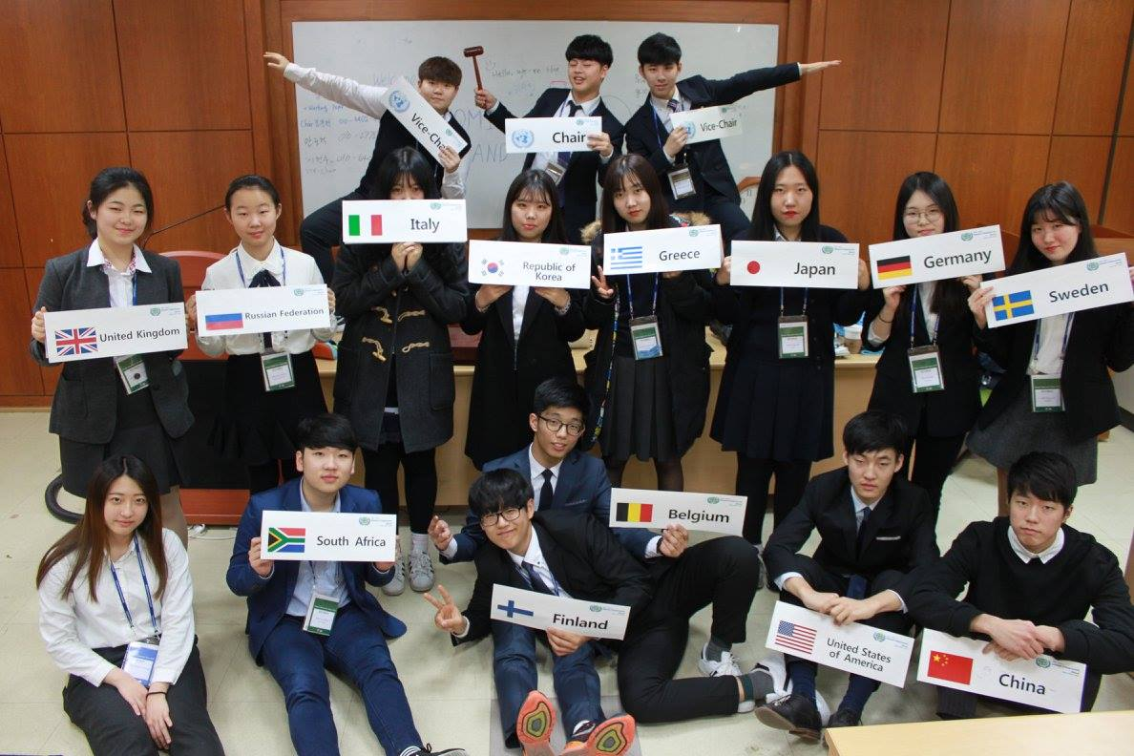
Conference

Slide 31
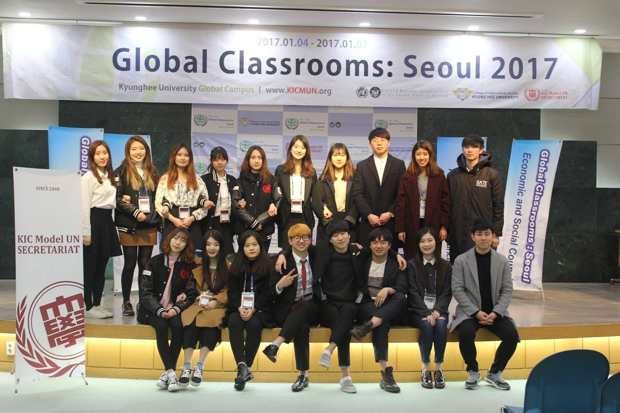
Conference

Slide 32
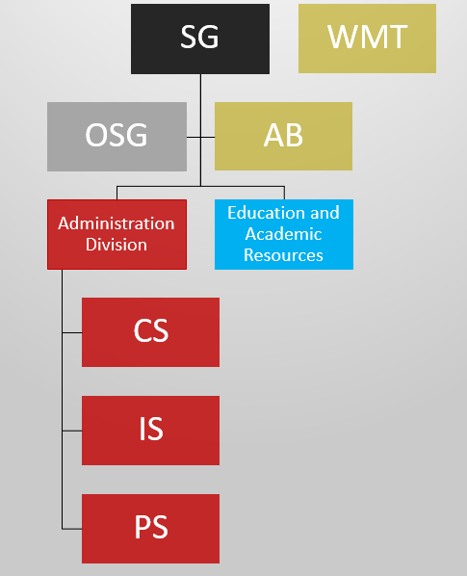
KIC Model UN SECRETARIAT

Slide 33
KIC Model UN SECRETARIAT
Office of the Secretary-General
Advisory Board
Administration Division
-Department of Conference Service
-Department of Information Service
-Department of Promotion Service
Education and Academic Resources Division
지원 가능한 부서는 CS, IS, PS, ENA 입니다

Slide 34
Department of Conference Service
Finance
Conference Venues
Conference Materials (Meals, Souvenirs and etc)
이 부서는 대회기획부 입니다.
이 부서에서는 대회의 예산집행부터 장소대여 및 대회와 관련된 물품을 구비합니다.
부서에 들어오시게 되면 위에 작성된 업무들을 하게 되며, 대회의 기본적인 구성이 되는 부서라고 할 수 있겠습니다.

Slide 35
Department of Information Service
Logistics
Registration and Database
Budget Check
Communication
-E-mail Replies
-Issue Letters of Excuse
이 부서는 정보관리부입니다.
대회와 관련된 참가자 정보관리, 스케쥴 관리 등이 주된 곳으로, 엑셀 업무를 많이 진행하는 부서입니다.
뿐만 아니라, 참가자들과 소통하는 수단인 이메일 등을 자주 이용하는 부서입니다.

Slide 36
Department of Promotion Service
External Affairs and Networking Department
-Advertising Online
-Social Network System (Blogs and Facebook)
-Letter of Excuse and Invitation Letter
Multimedia and Design
-Videos and Poster Design
-Web Master
이 부서는 디자인/홍보부 입니다.
홍보와 디자인을 동시에 같이 하는 부서입니다.
기본적인 SNS관리 부터, 온라인 홍보 체크업 등을 진행하며, 영상 및 포스터 디자인 그리고 홈페이지 관리 등이 주된 업무입니다.

Slide 37
Education and Academic Resources
Outreach Partnership (KIMO)
Research and Education Department
-Rules of Procedure Education for 10th secretariat
KICMUN Workshop Department
이 부서는 교육지원부입니다.
들어오시게 되면 MUN의 기본적인 것 중 하나인 ROP 교육을 받게 되며, 이 부서의 일원이 되신다면:
1. 중고등학생 교육
2. 의장단 및 사무국 추가 교육
3. 델리겟 교육
1번 항목 같은 경우 중고등학생들을 대상으로 교육 진행 (필요 시 2,3번 교육 추가 진행)

Slide 38
Career Prospects

Slide 39
Extracurricular Activities & Academics
Extracurricular Activities
-Membership Training (MT) 3 times annually
-Nights of the Secretariat
Academics
-Intern at the United Nations
-Major Intensive Programs

Slide 40
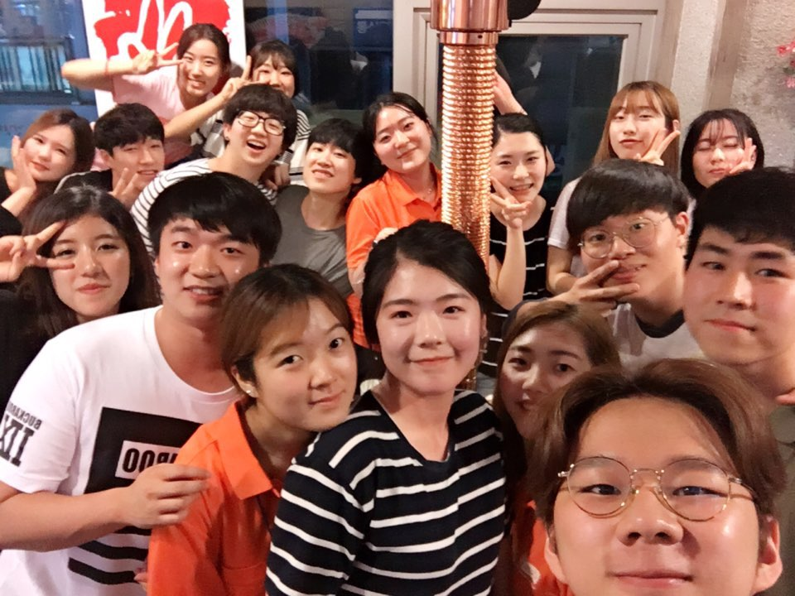
KIC Model UN SECRETARIAT

Slide 41
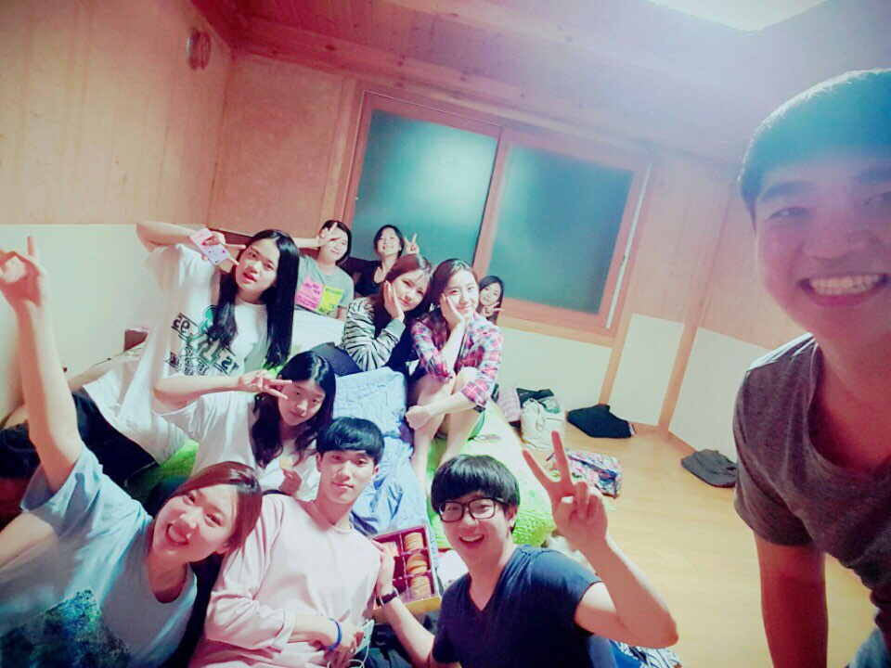
KIC Model UN SECRETARIAT

Slide 42
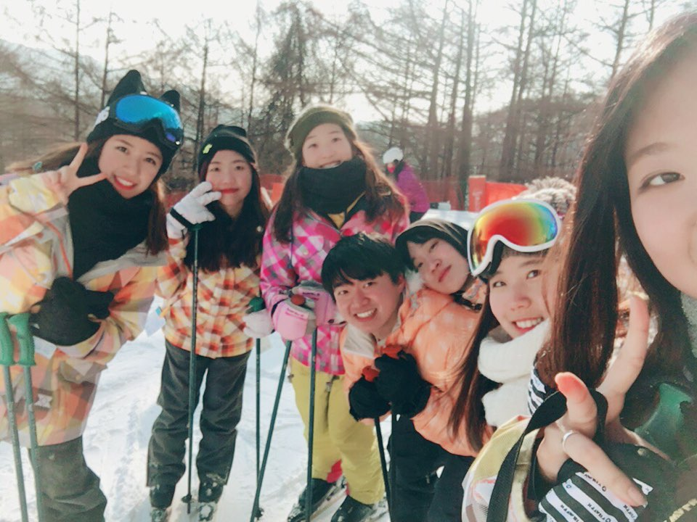
KIC Model UN SECRETARIAT

Slide 43
How to APPLY
Schedule
March 6th ~ March 19th Application Submission Date
March 20th Application Overview
March 21st ~ 24th Interview
March 27th Final Results of Applicants
March 29th First Meeting
How?
Offline : Visit Room 214 in the building of International College
Online : kicmun@naver.com

Slide 44
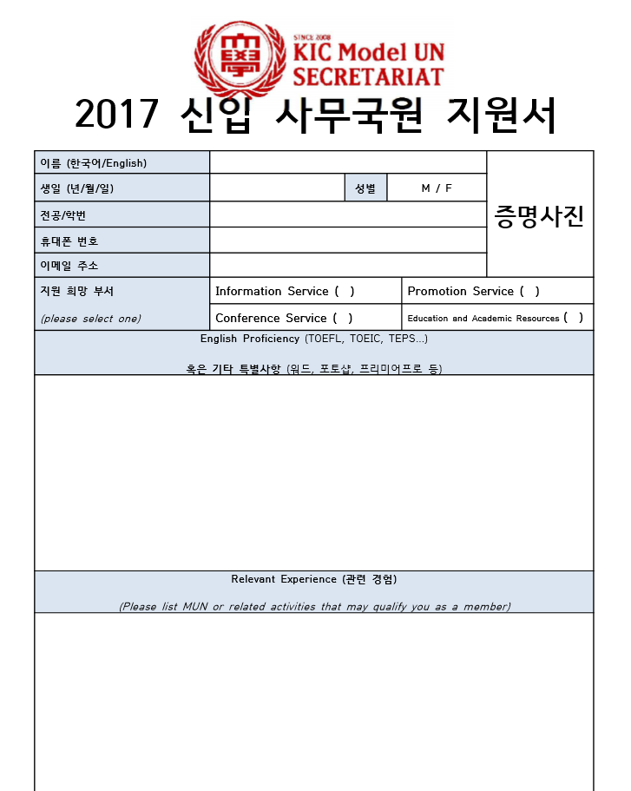
KIC Model UN SECRETARIAT

Slide 45
Who We Want

Slide 46
KIC Model UN SECRETARIAT
*매주 정기회의는 수요일 오후 7:30에 진행됩니다.
신세와 겹치지 않습니다.

Slide 47
Contact Us
Office: Int’l College Building Rm. 214
Contact Number: 031-201-2325 (9:00 to 17:00)
Kakaotalk: @kicmun
E-mail: kicmun@naver.com
Official Site: www.kicmun.org
Facebook: www.facebook.com/kimunsecretariat
Naver Blog: blog.naver.com/kicmun
*Secretary General
AHN Seon Woo (010-7764-5431)

